Slide 1
07. Med-fi Prototype 2 & Usability Study
Team Mango - nurturEd
May 17, 2023
CS 337E: Design for Global Grand Challenges

Slide 2

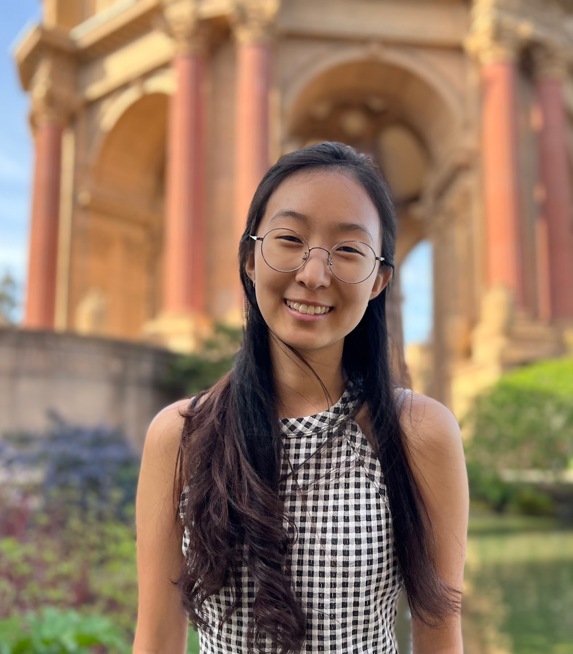
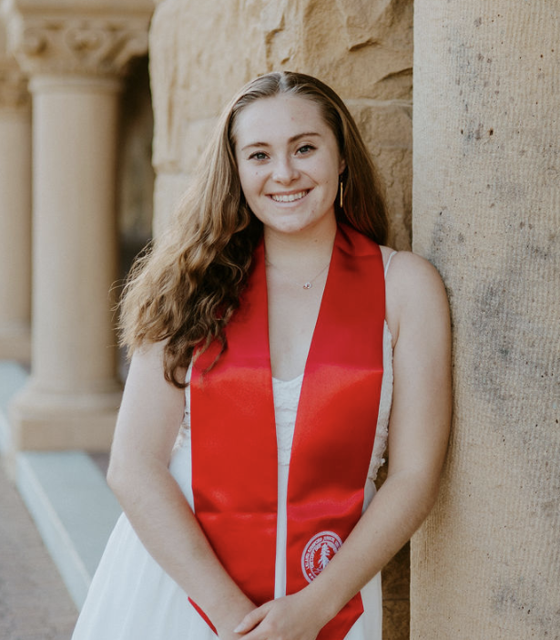
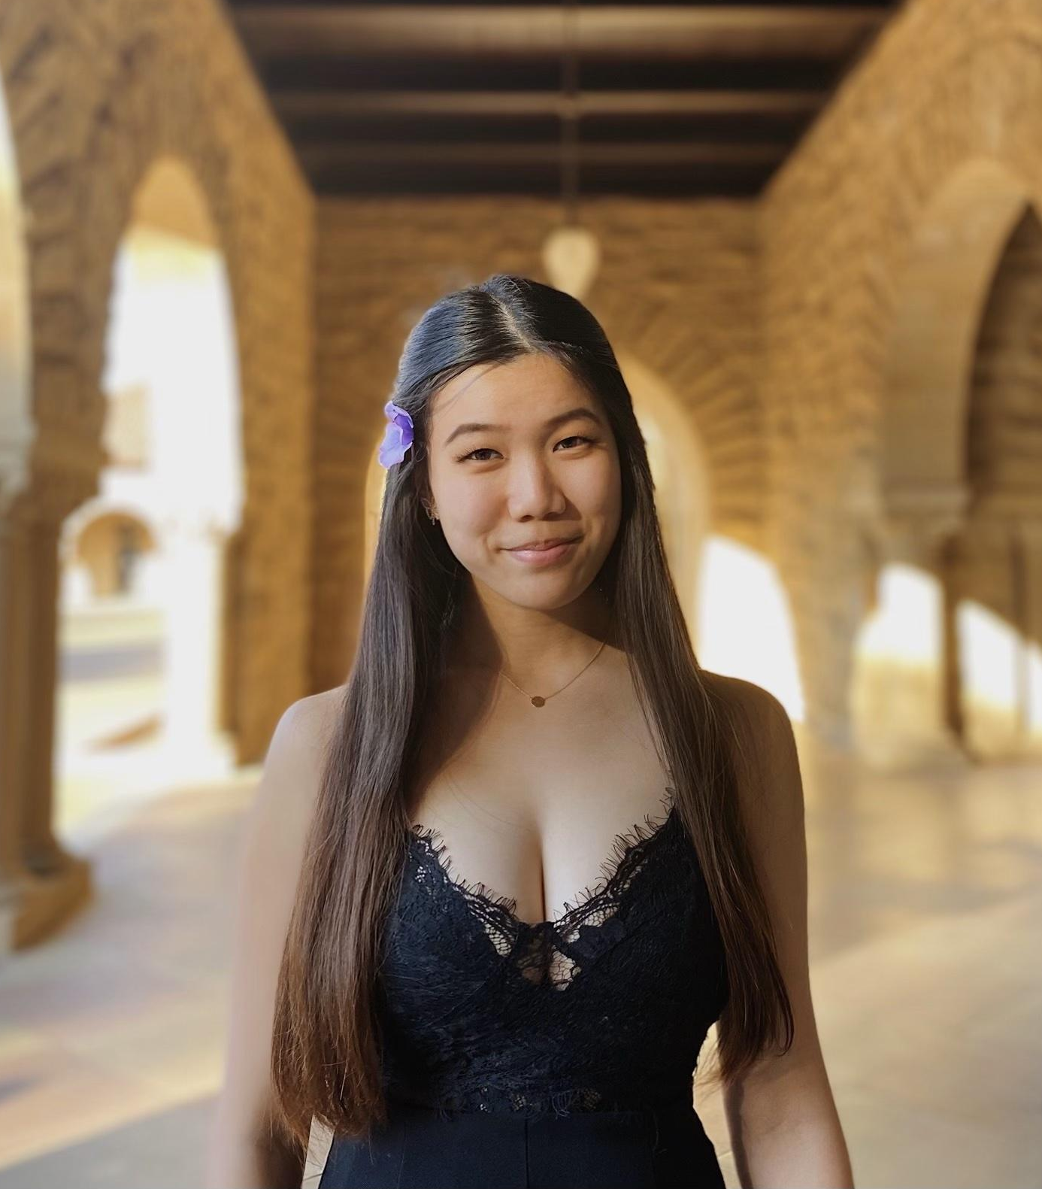
Team Mango
Homeschool Education
Nathan M.
Christina K.
Claire M.
Grace Z.
CS, AI Coterm
Econ, HCI Coterm
CS, HCI Coterm
CS, HCI Coterm

Slide 3
Overview
Initial Med-Fi Feedback
Redesign 1
Usability Study
Redesign 2
AI Applications

Slide 4
Initial Med-Fi Feedback
Lesson Report: ChatGPT output overload
Too much text
Need sequential information design
Lesson Report List Filter
Readability: color issue

Slide 5
Redesign 1
Link to Figma

Slide 6
Redesign 1
Lesson Report
AI Agent
Lesson Reports List Filter

Slide 7
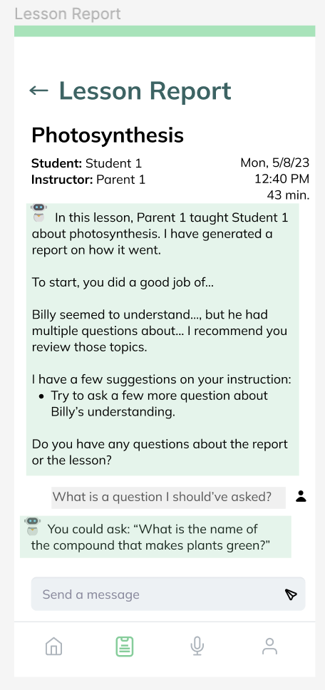
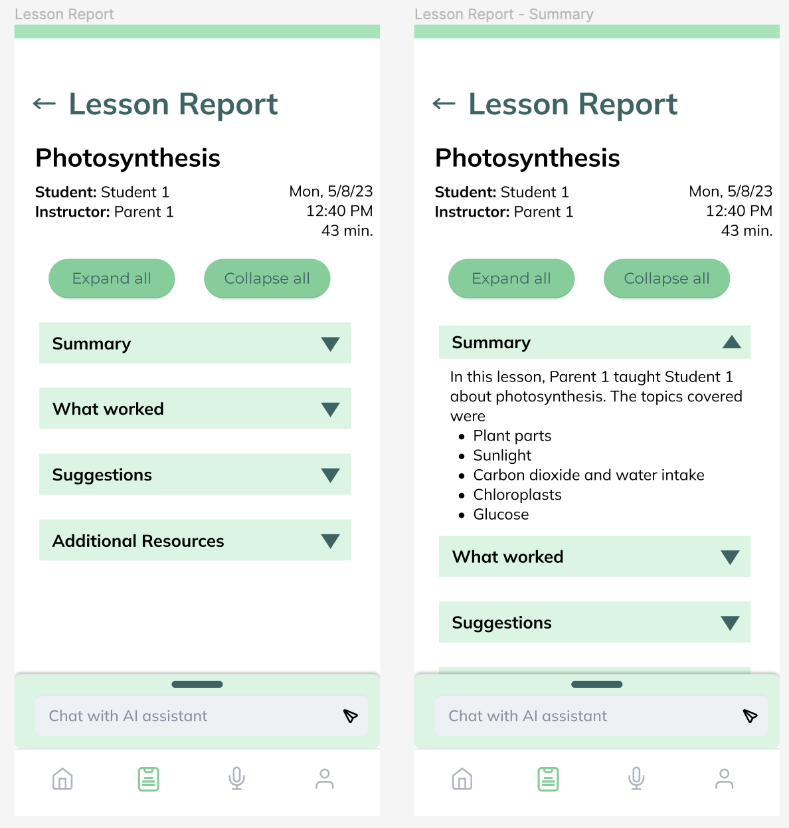
Lesson
Reports
Before
After

Slide 8
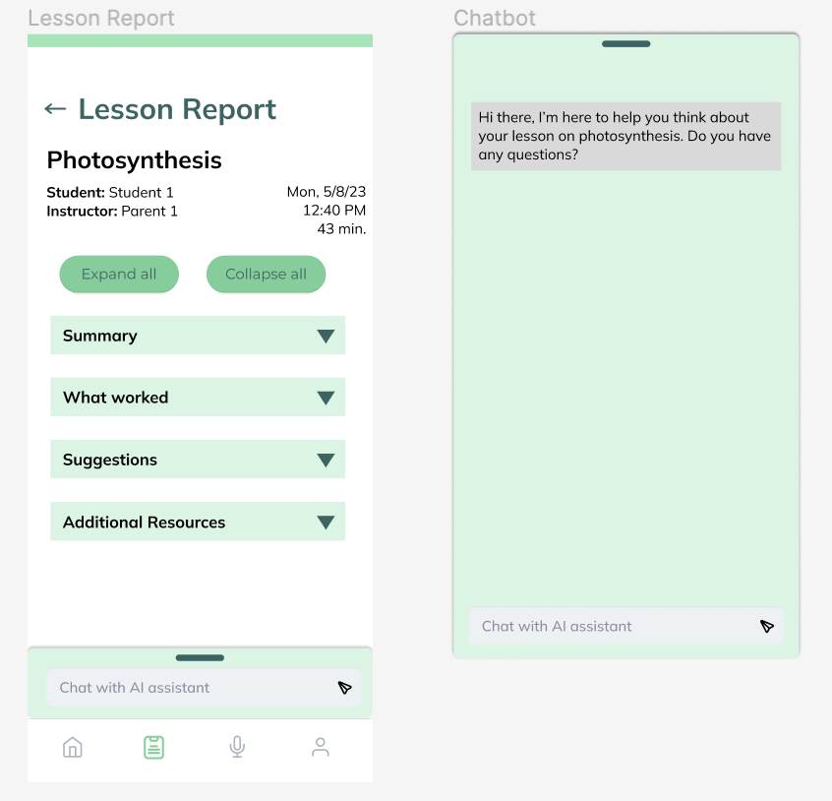
AI
Agent
Before
After

Slide 9
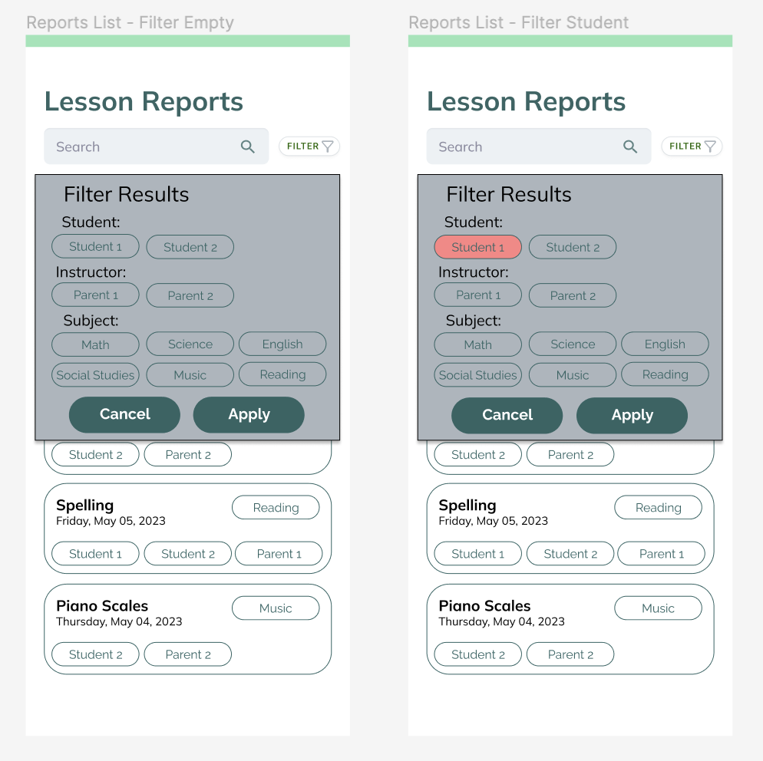
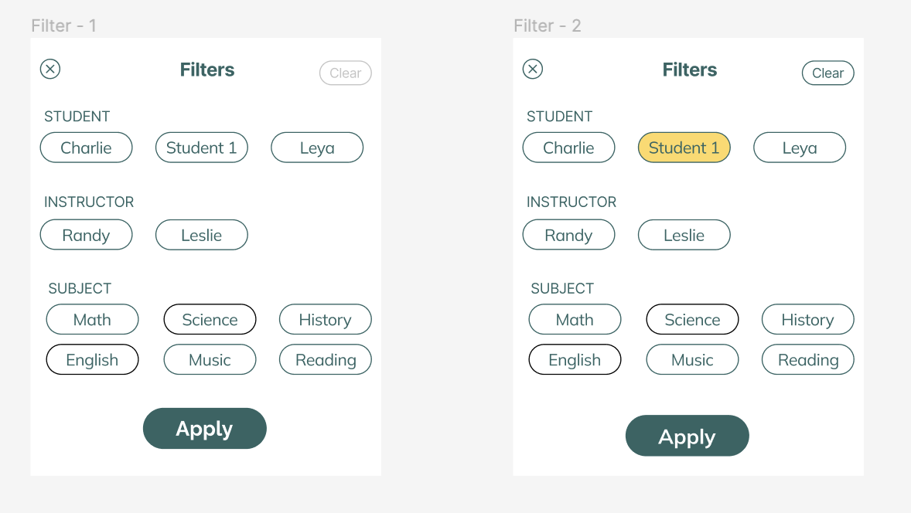
Lesson
Reports
List
Filter
After
Before

Slide 10
Usability Study

Slide 11

Participants
Homeschooling mother of 2
(Zoom)
Homeschooling mother of 2
(Zoom)
Homeschooling expert
(BlueJeans)
Homeschooling mother of 2
(Zoom)

Slide 12
Study
Goals
Test UI
Test UX
Test interest in functionality
Tasks
Explore tip of the day
Record a lesson
Open lesson report & interact with AI agent

Slide 13
Results
User Interface
User Experience
Functionality

Slide 14
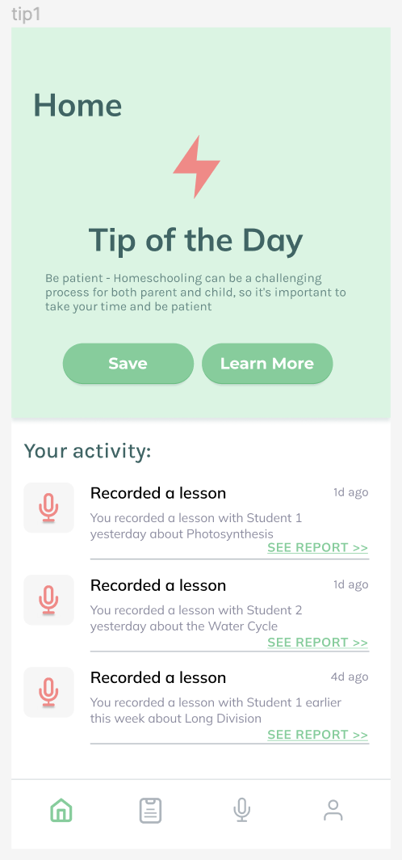
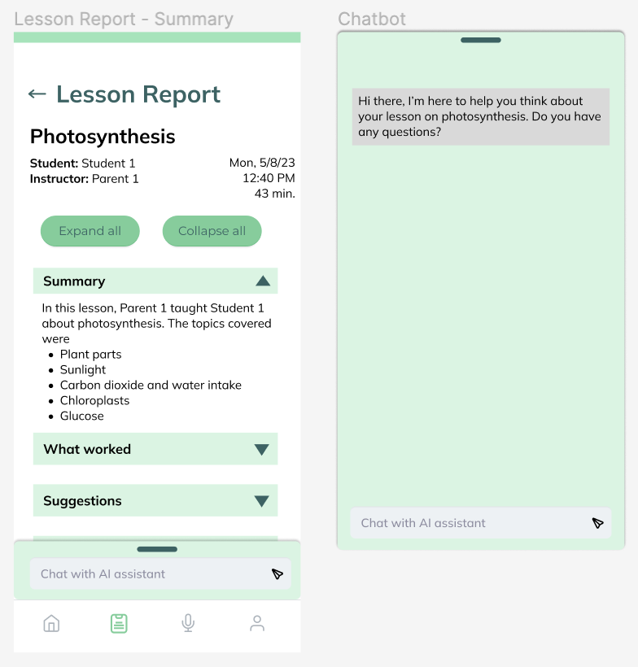

User Interface Results
“I’m old, so the font is small.” - P1
Font too small
Home page microphone confusing
Interactive elements too small

Slide 15
User Experience Results
Confusion about recording privacy
“Who gets to see this when it gets uploaded?” - P2
3 of 4 participants confused
Wanted voice modality for AI agent
“Oh my gosh, I’ve got to write this out!” - P1

Slide 16
Functionality Results
AI agent not easily accessible in reports
Need general chat
Differentiate content and methodology suggestions
“If you think of [homeschooling] families [without external support], this is the perfect solution if you include methodology.” - P4

Slide 17
Redesign 2
Link to Figma

Slide 18
Redesign 2
Lesson Report
AI Agent
Lesson Reports List
Tip of the Day
Lesson Recording

Slide 19
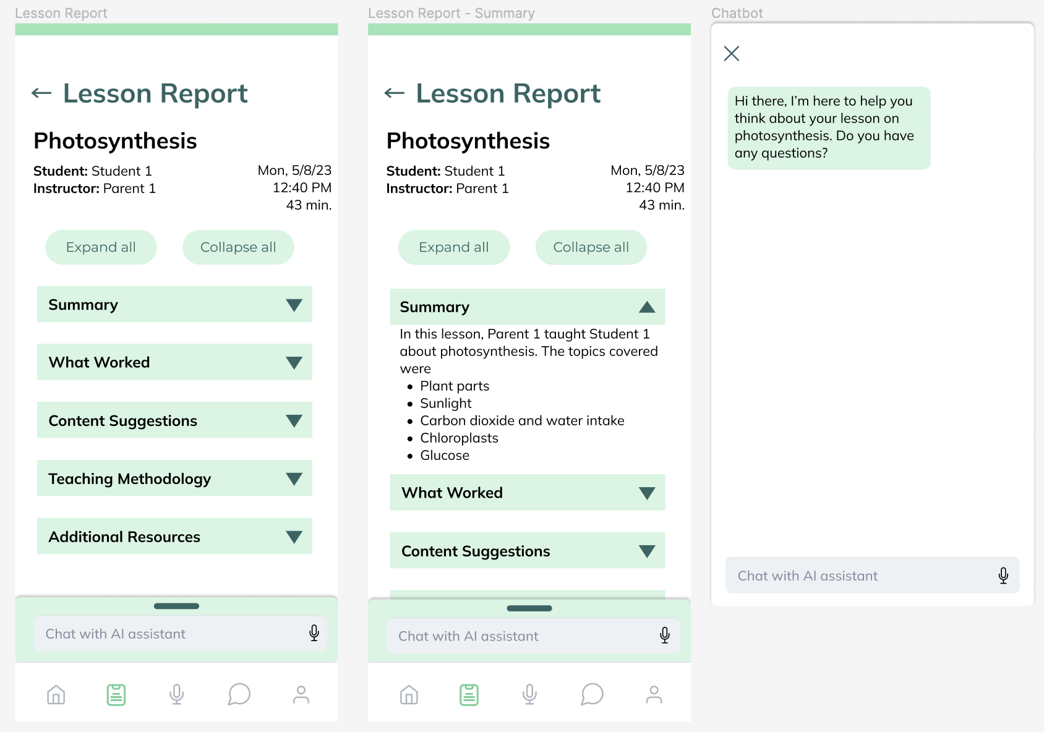
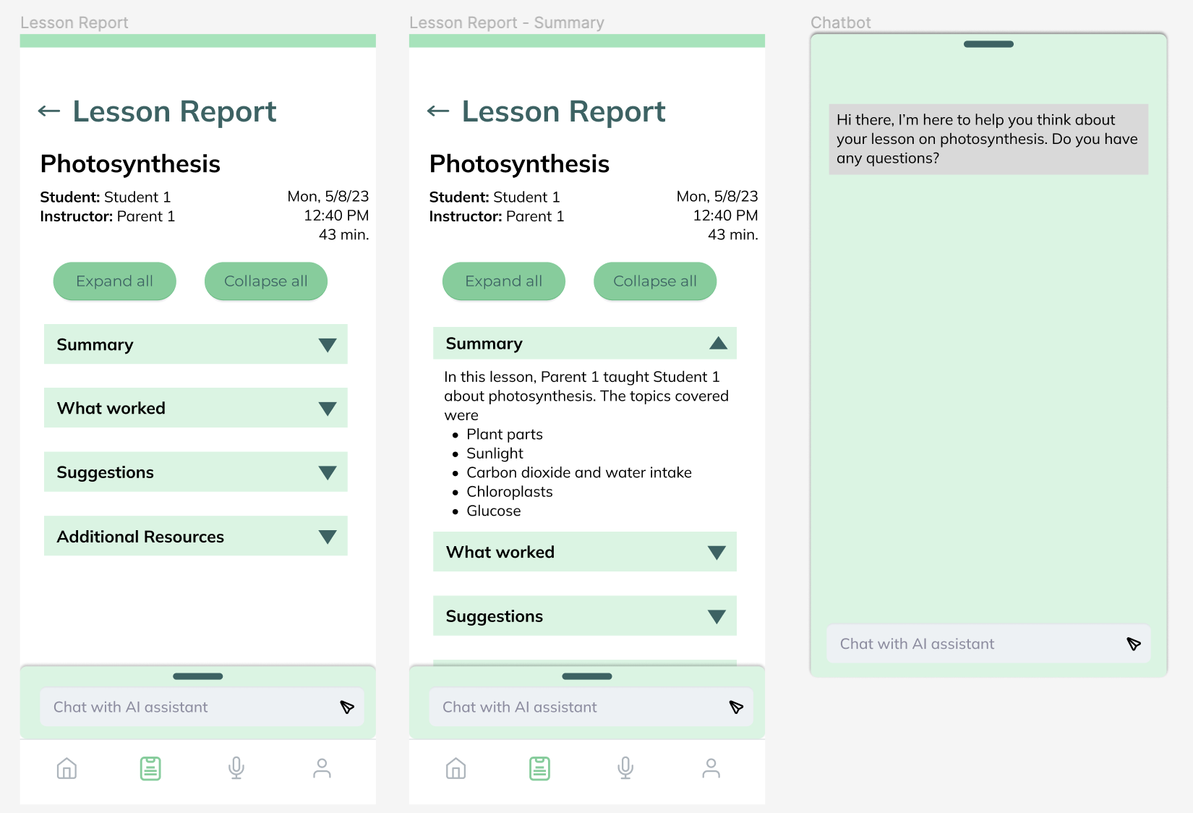
Redesign 2: Lesson Report
Before
After

Slide 20
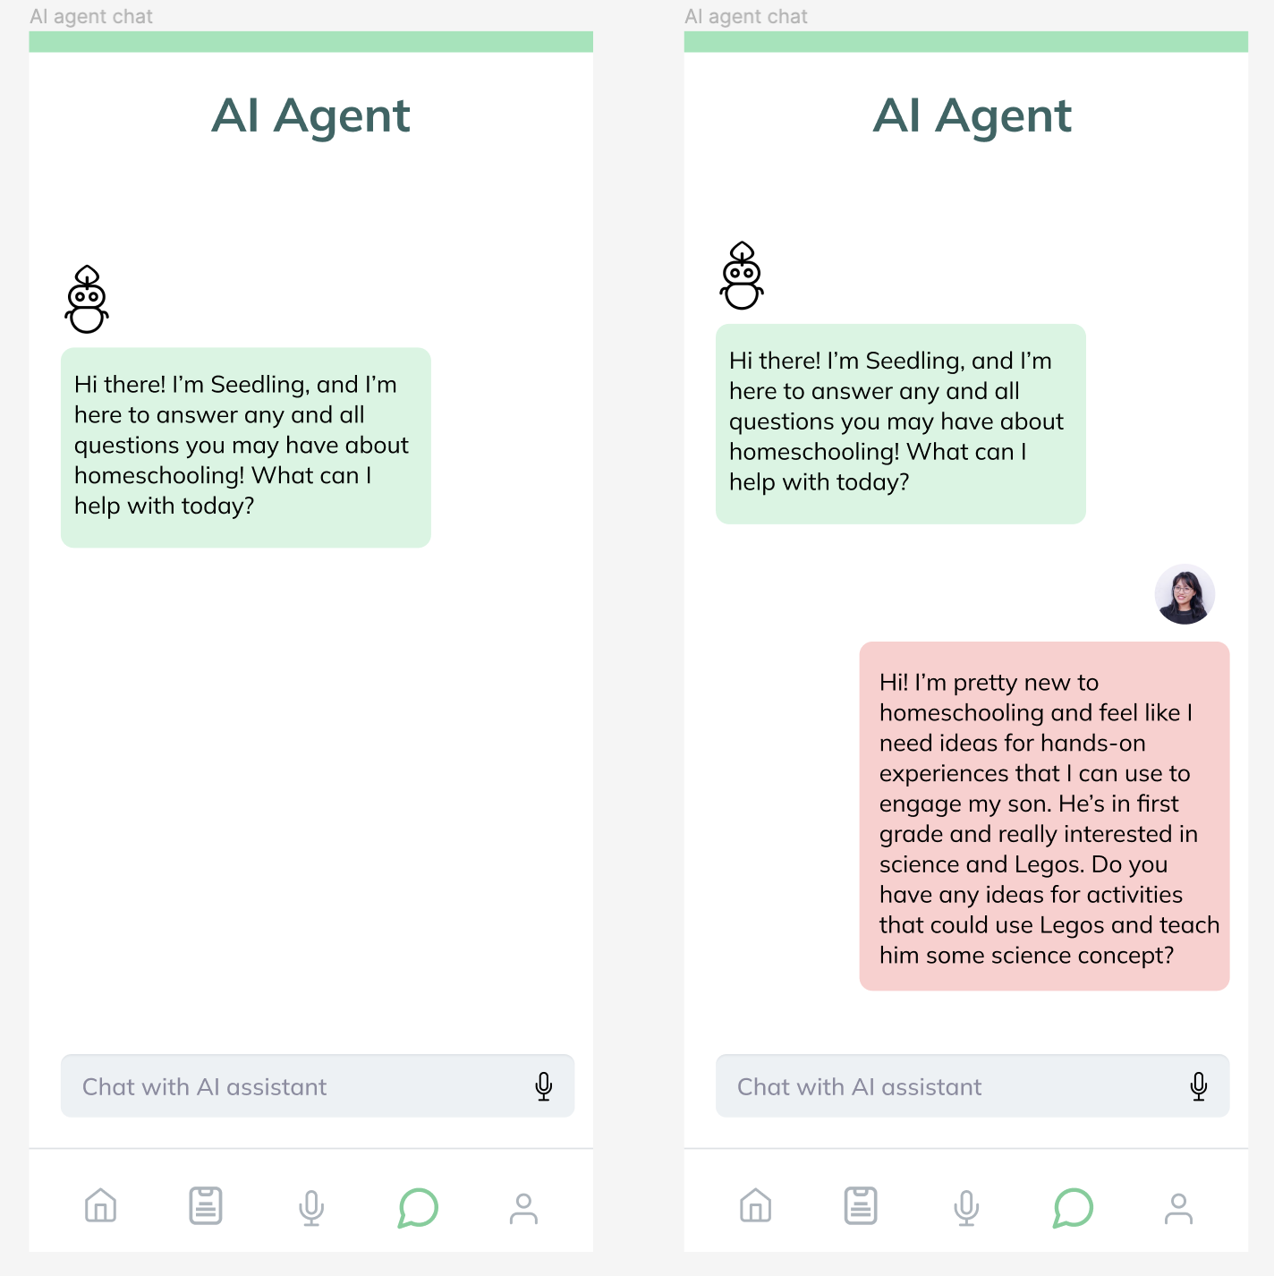
Redesign 2: General AI Agent
“You’re providing parents with the kind of expertise they would get when sitting down with an education expert.” - P4

Slide 21
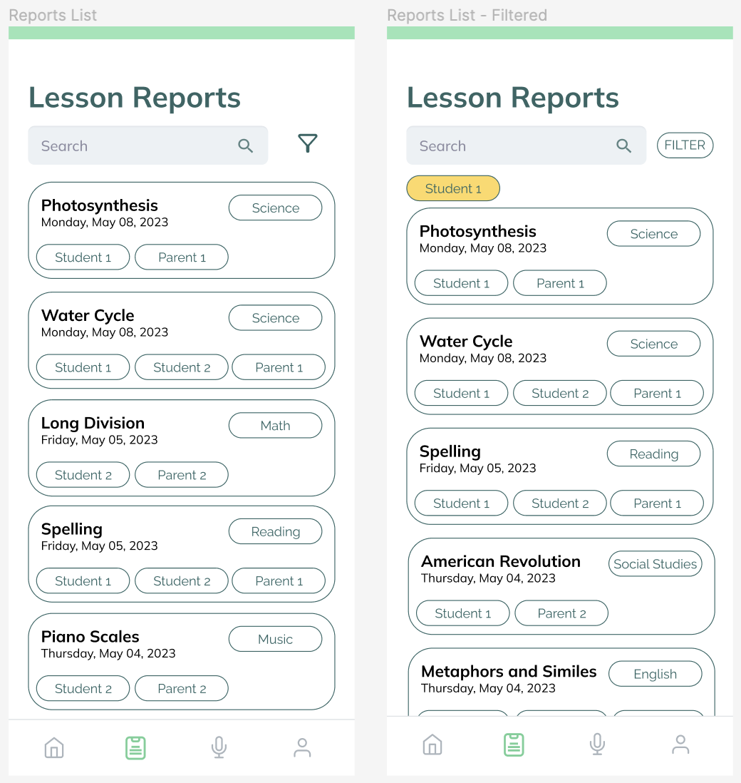
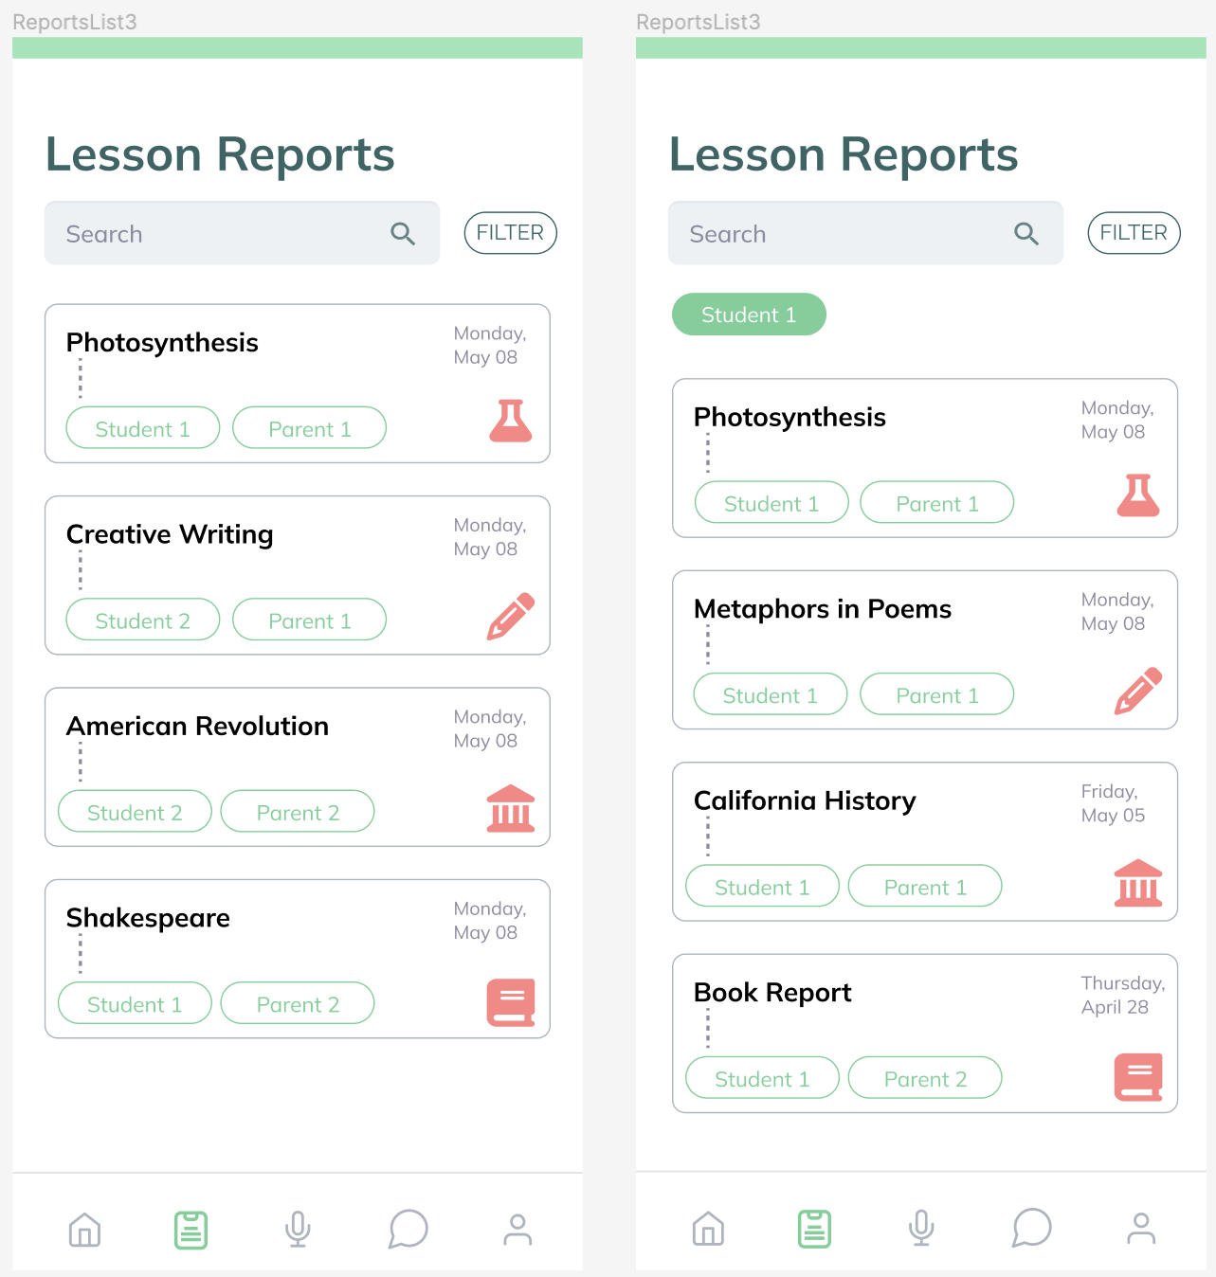
Redesign 2: Lesson Reports List
Before
After

Slide 22
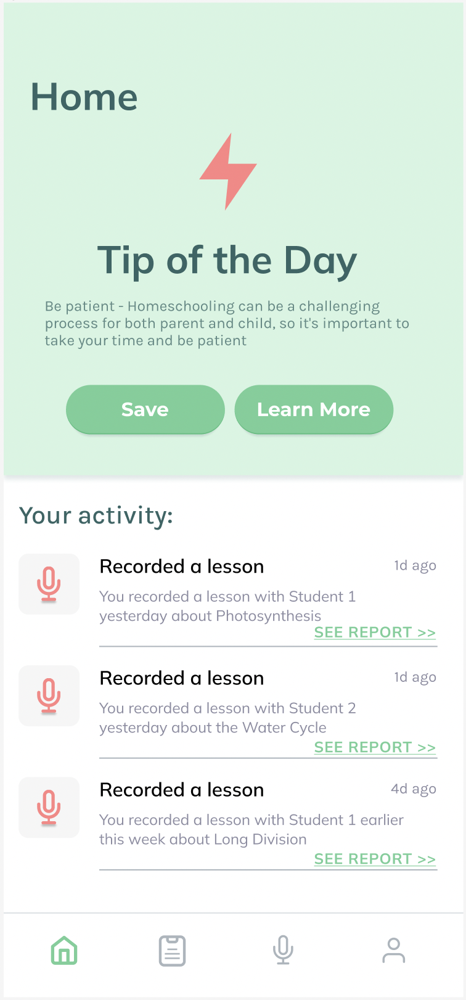
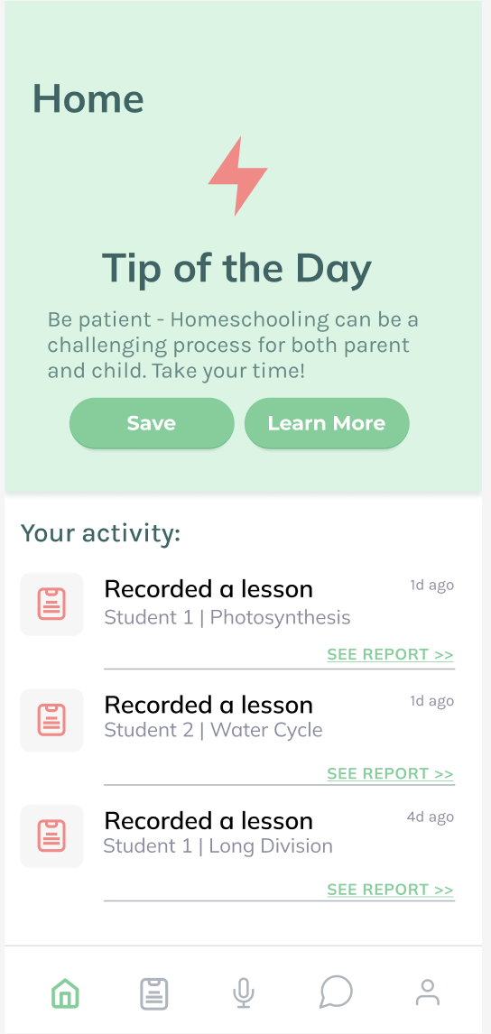
Redesign 2: Tip of the Day
Before
After

Slide 23
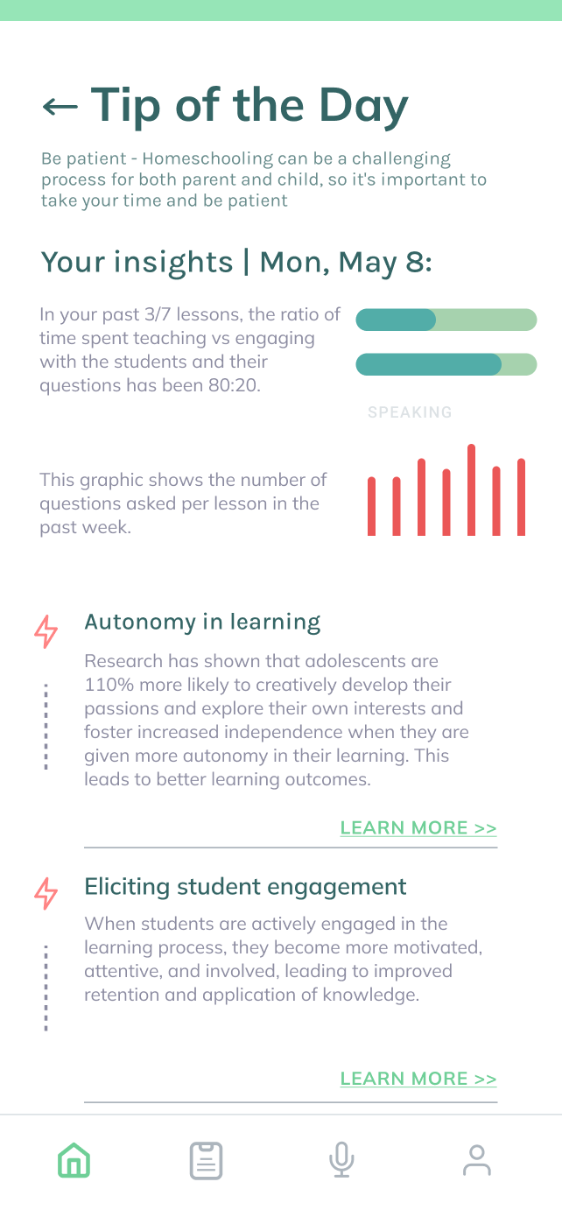
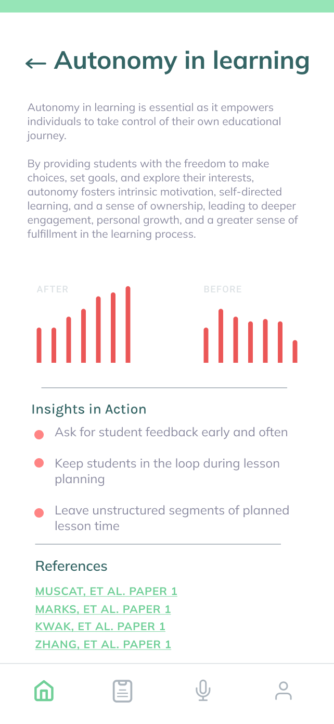
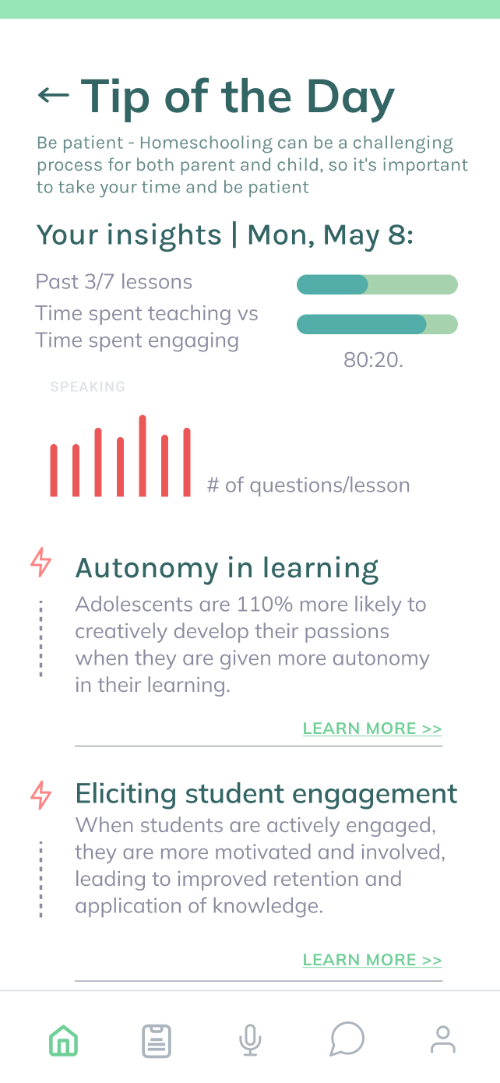
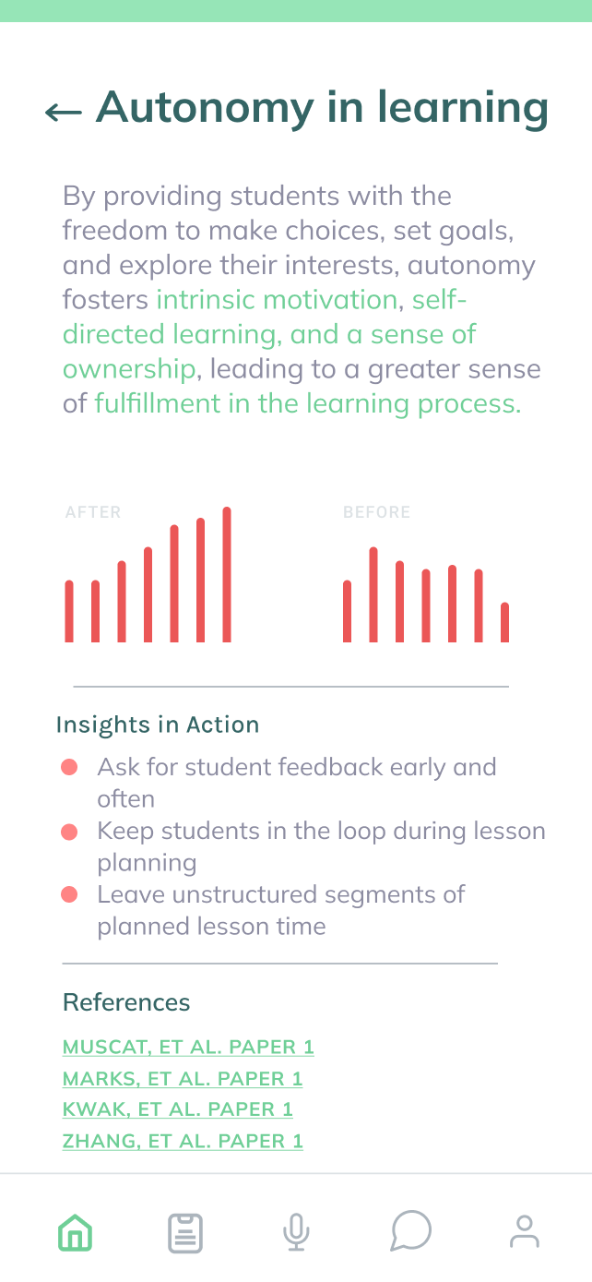
Redesign 2: Tip of the Day
Before
After

Slide 24
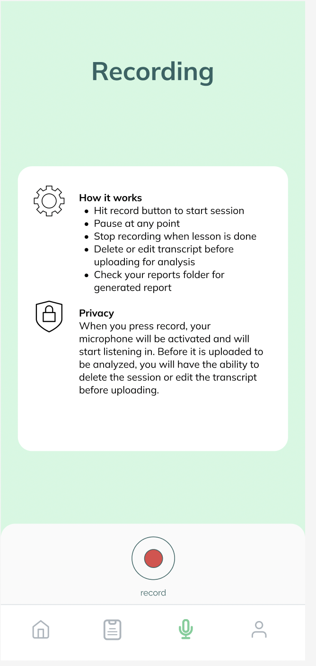
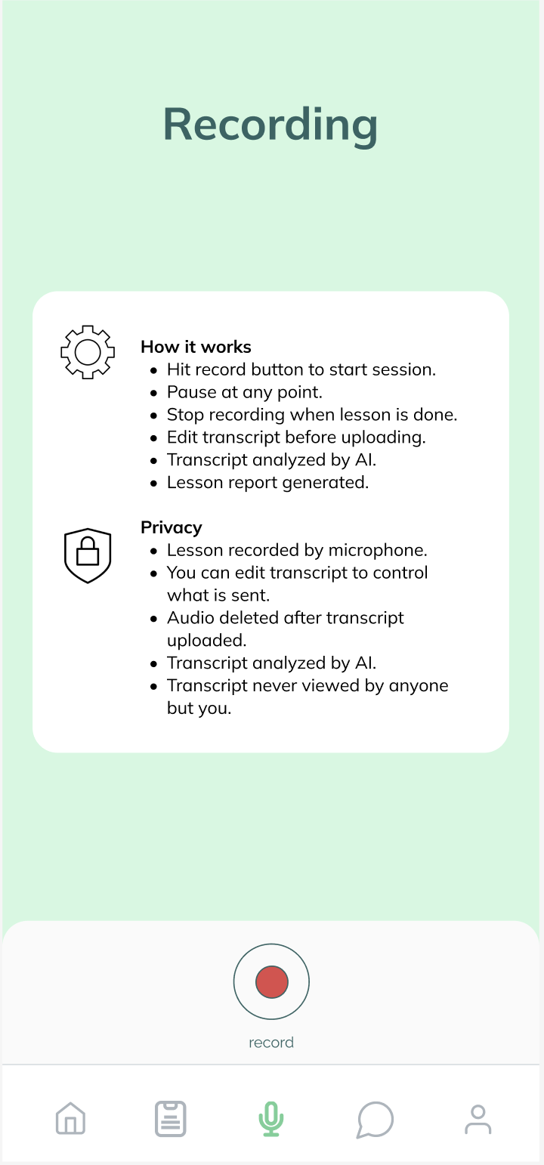
Redesign 2: Lesson Recording
Before
After

Slide 25
AI Applications

Slide 26
AI Applications
Lesson speech to text
Generated lesson reports
Information sectioned by topic
Interactive AI agent
Lesson-specific
General

Slide 27
Thank you!
Questions? Feedback?

Slide 28
Appendix

Slide 29
Link to Report
https://docs.google.com/document/d/1IskvRsZR5QBc3FDfkF3DyniksQuoG1d73ZQel29CK3I/edit

